Slide 1
Generative Neural Networks, Convolutional Networks, Recurrent Networks
CSN-382

Slide 2
Generative Neural Networks
So far we have looked at networks that solve prediction problems like (binary,multiclass/label)classification, regression etc
Neural networks can also be used to learn generative models
Can be used for dim. redn. as well as to generate new data points
(Variational) Autoencoders (Kingma & Welling 2013, Rezende et al. 2014) and Generative adversarial networks (Goodfellow et al 2014) are two popular generative models that use neural networks
Will describe them using feedforward networks but they can be formed out of CNNs or RNNs as well

Slide 3
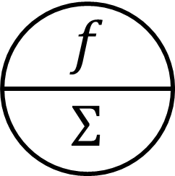

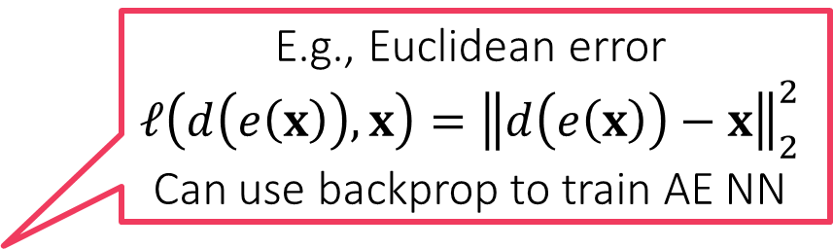


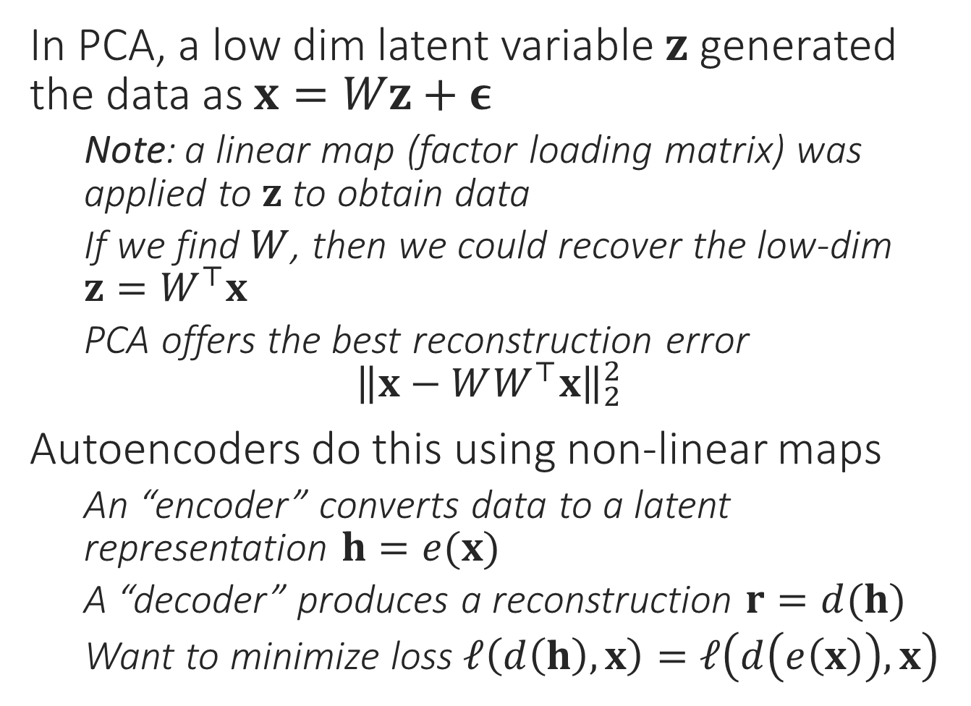






Autoencoders
In PCA, a low dim latent variable $z$ generated the data as $x=Wz+ε$
Note: a linear map (factor loading matrix) was applied to $z$ to obtain data
If we find $W$, then we could recover the low-dim $z=W^{⊤}x$
PCA offers the best reconstruction error ${\left\|x−WW^{⊤}x\right\|}_{2}^{2}$
Autoencoders do this using non-linear maps
An “encoder” converts data to a latent representation $h=e(x)$
A “decoder” produces a reconstruction $r=d(h)$
Want to minimize loss $ℓ\left(d\left(h\right),x\right)=ℓ\left(d\left(e\left(x\right)\right),x\right)$
$$id$$
$$id$$
$$id$$
$$id$$
$$W^{2}$$
$$\text{id}$$
$$\text{id}$$
$$\text{id}$$
$$W^{1}$$
E.g., Euclidean error
$$ℓ\left(d\left(e\left(x\right)\right),x\right)={\left\|d\left(e\left(x\right)\right)−x\right\|}_{2}^{2}$$
Can use backprop to train AE NN

Slide 4


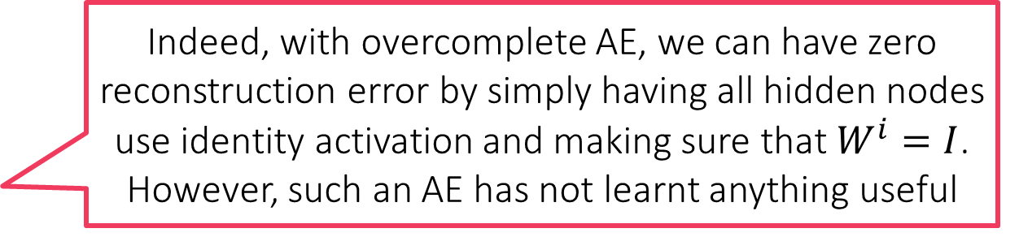



Autoencoders
$$id$$
$$id$$
$$id$$
$$id$$
Decoder
PCA can be thought of as a linear autoencoder
Just like PCA, autoencoders are trained to lower reconstruction error using backpropagation
The “hourglass” architecture very popular in AE
Gradually decreases dimensionality of data
However, a monotonic decrease not necessary
E.g. 784 →1000→500→250→30→250→500→1000→784 on MNIST data (Hinton and Salakhutdinov)
In fact some autoencoders do not decrease dim at all
Called overcomplete autoencoders. Recall that as in kernel PCA, goal may be to find better features not fewer features
Autoencoders can overfit badly too – just memorize data and offer no useful dim red on test data
Various techniques to regularize AE
$${\tilde{W}}^{1}$$
“Bottleneck”. For overcomplete AE, bottleneck may have more neurons than input layer. For undercomplete neurons, less neurons than input layer in bottleneck layer so dim redn
$${\tilde{W}}^{2}$$
Encoder
$$W^{2}$$
Indeed, with overcomplete AE, we can have zero reconstruction error by simply having all hidden nodes use identity activation and making sure that $W^{i}=I$. However, such an AE has not learnt anything useful
$$W^{1}$$

Slide 5
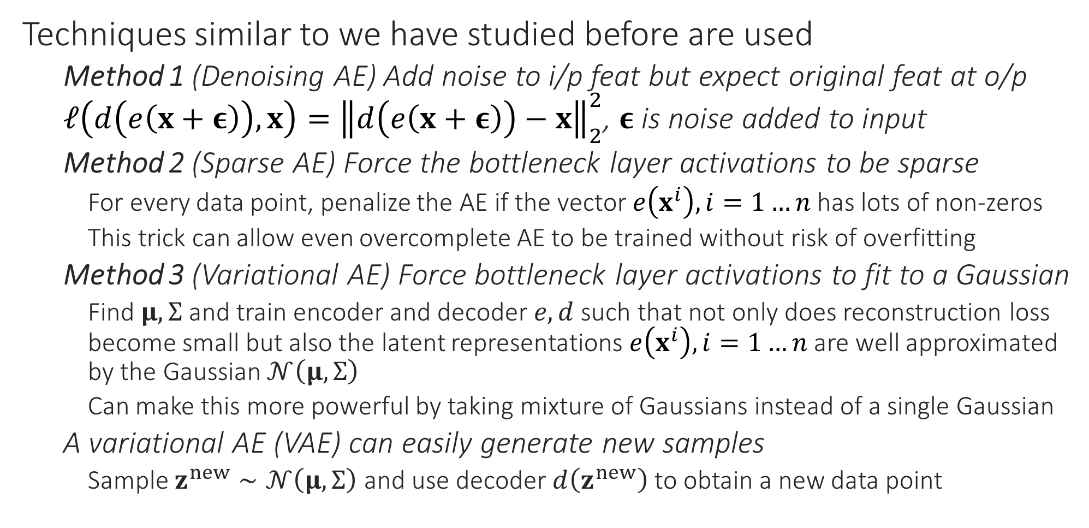
Regularized Autoencoders
Techniques similar to we have studied before are used
Method 1 (Denoising AE) Add noise to i/p feat but expect original feat at o/p $ℓ\left(d\left(e\left(x+ε\right)\right),x\right)={\left\|d\left(e\left(x+ε\right)\right)−x\right\|}_{2}^{2}$, $ε$ is noise added to input
Method 2 (Sparse AE) Force the bottleneck layer activations to be sparse
For every data point, penalize the AE if the vector $e\left(x^{i}\right),i=1…n$ has lots of non-zeros
This trick can allow even overcomplete AE to be trained without risk of overfitting
Method 3 (Variational AE) Force bottleneck layer activations to fit to a Gaussian
Find $μ,Σ$ and train encoder and decoder $e,d$ such that not only does reconstruction loss become small but also the latent representations $e\left(x^{i}\right),i=1…n$ are well approximated by the Gaussian $𝒩\left(μ,Σ\right)$
Can make this more powerful by taking mixture of Gaussians instead of a single Gaussian
A variational AE (VAE) can easily generate new samples
Sample $z^{new}∼𝒩\left(μ,Σ\right)$ and use decoder $d\left(z^{new}\right)$ to obtain a new data point

Slide 6
Generative Adversarial Networks
Do not aim to offer good reconstruction error – sole aim is to produce new data points that are realistic and distributed as training data points
E.g. given tons of cat images, generate new ones (as if there weren’t enough of them around already) but make sure the new ones do look like cats
Uses two networks to perform this – a generator network which attempts to generate new samples, and a discriminator network which attempts to distinguish samples generated by the generator from actual training data
If the discriminator is unable to tell the generator’s samples from actual data then this means the generator has learnt to generate realistic data (or else that the discriminator is weak and needs to be strengthened)
Interesting interpretation of GAN tells us that the discriminator supplies the generator with the gradients it needs to train itself
Thus, instead of calculating backprop gradients from data, another NN (in this case the discriminator) “learns” the gradients for the generator ☺

Slide 7
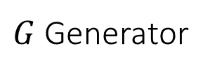
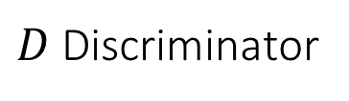
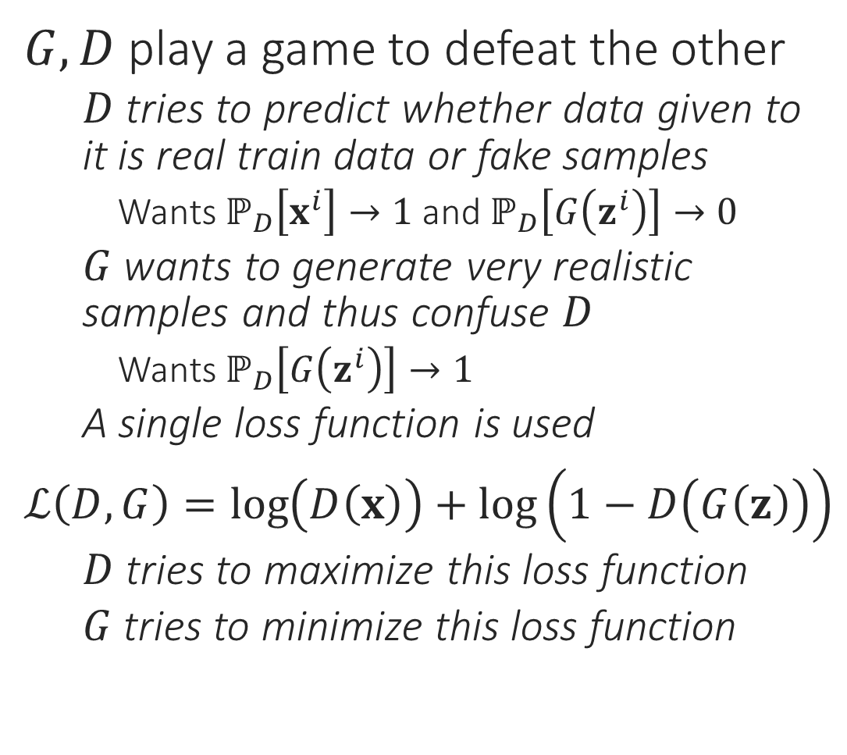
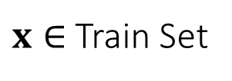


GANs – a toy depiction
$$ℙ\left[\text{image} \text{is} \text{genuine}\right]$$
$G,D$ play a game to defeat the other
$D$ tries to predict whether data given to it is real train data or fake samples
Wants $ℙ_{D}\left[x^{i}\right]→1$ and $ℙ_{D}\left[G\left(z^{i}\right)\right]→0$
$G$ wants to generate very realistic samples and thus confuse $D$
Wants $ℙ_{D}\left[G\left(z^{i}\right)\right]→1$
A single loss function is used
$ℒ\left(D,G\right)=\log\left(D\left(x\right)\right)+\log\left(1−D\left(G\left(z\right)\right)\right)$
$D$ tries to maximize this loss function
$G$ tries to minimize this loss function
$D$ Discriminator
$x∈$ Train Set
$G$ Generator
$$z∈𝒩\left(0,I_{k}\right)$$

Slide 8
Convolutional Networks
Need for convolutional networks (weight sharing, local features)
Notions of convolutions and pooling
Creating multi-layered convolutional networks

Slide 9
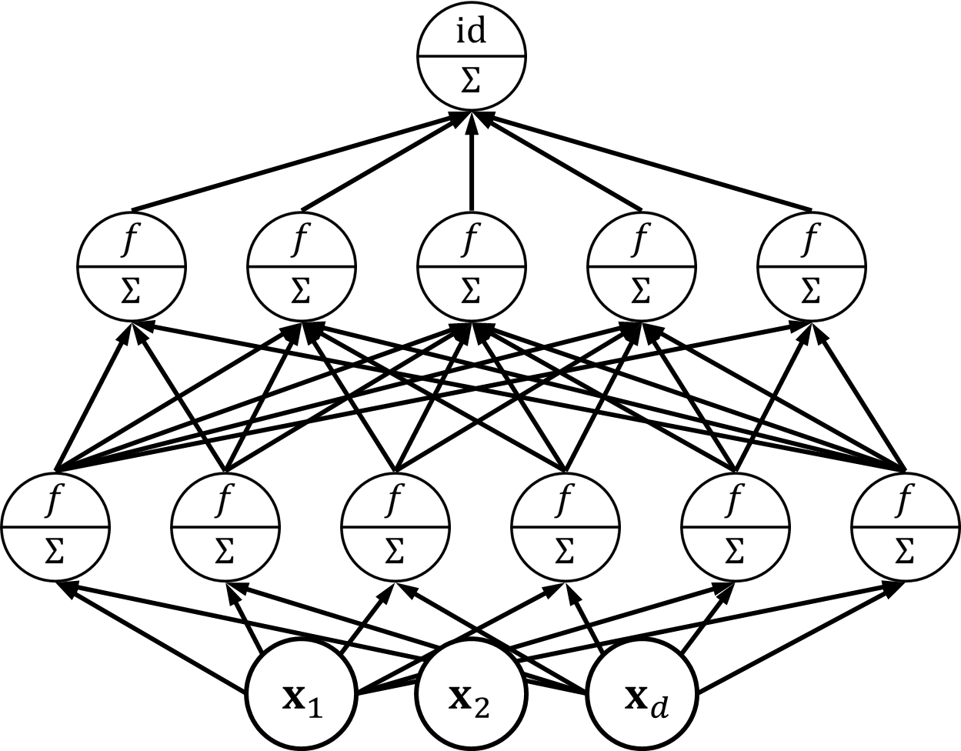
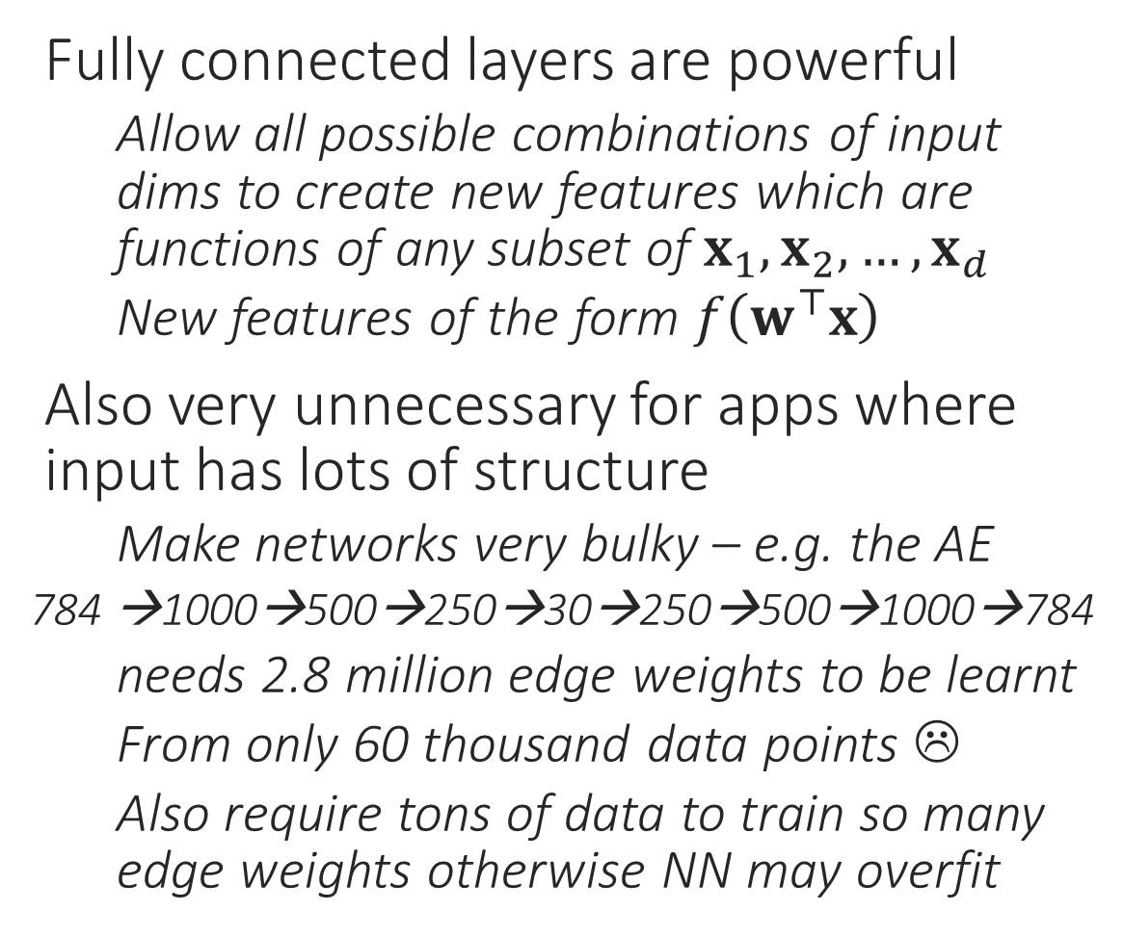
Feedforward Networks can be massive
Fully connected layers are powerful
Allow all possible combinations of input dims to create new features which are functions of any subset of $x_{1},x_{2},…,x_{d}$
New features of the form $f\left(w^{⊤}x\right)$
Also very unnecessary for apps where input has lots of structure
Make networks very bulky – e.g. the AE
784 →1000→500→250→30→250→500→1000→784
needs 2.8 million edge weights to be learnt
From only 60 thousand data points ☹
Also require tons of data to train so many edge weights otherwise NN may overfit

Slide 10
Structured Data needs Local Features
EYE
EYE
MOUTH
Highly unlikely that top left and bottom right pixels would need to be considered together right at the first hidden layer to detect edges
Only neighboring pixels need to talk to each other to detect edges. Also, edge detection happens via “filters” – same filter needs to be applied everywhere
Then, need to aggregate info to detect structures
Then, need to detect even higher level features
Distant pixels are jointly considered, but at a much later stage (deeper layer)

Slide 11
Convolution Operation
Convolutions are at the heart of signal processing and CNNs
Convolutions create layers which are sparsely connected
Only 18 edges, fully connected layer would have had 48 edges

Slide 12
Convolution Operation
Convolutions are at the heart of signal processing and CNNs
Convolutions create layers which are sparsely connected
On top of that they force equality constraints among weights in that layer
All green edges forced to have the same weight, all red edges forced to have the same weight, all blue edges …
So effectively only 3 edge weights to be learnt for this layer!
A fully connected layer would have had 48 edges

Slide 13


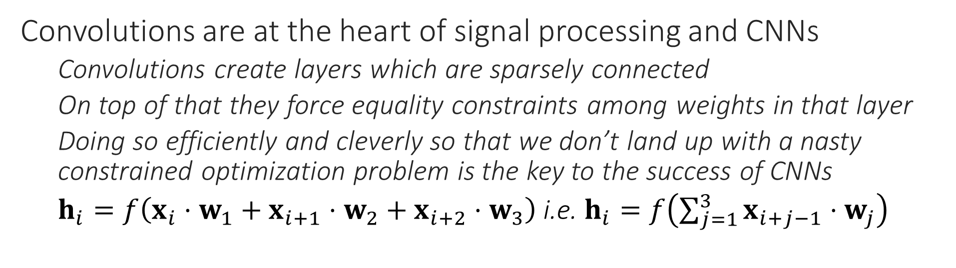
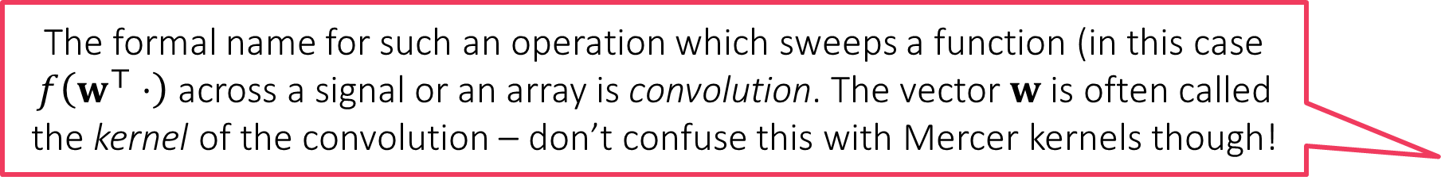
Convolution Operation
The formal name for such an operation which sweeps a function (in this case $f\left(w^{⊤}⋅\right)$ across a signal or an array is convolution. The vector $w$ is often called the kernel of the convolution – don’t confuse this with Mercer kernels though!
Convolutions have been around in image processing for decades. Earlier, people used to painstakingly design the kernels by hand (e.g. Canny filters) but CNNs allow us to learn the kernel of the convolution itself.
Convolutions are at the heart of signal processing and CNNs
Convolutions create layers which are sparsely connected
On top of that they force equality constraints among weights in that layer
Doing so efficiently and cleverly so that we don’t land up with a nasty constrained optimization problem is the key to the success of CNNs
$h_{i}=f\left(x_{i}⋅w_{1}+x_{i+1}⋅w_{2}+x_{i+2}⋅w_{3}\right)$ i.e. $h_{i}=f\left(\sum_{j=1}^{3}{x_{i+j−1}⋅w_{j}}\right)$
True, the idea is to allow difficult problems to be solved with a customized filter that works best for that problem. However, handcrafted filters may still offer good results for simple problems (and offer faster training since learning filters is not an easy task – the backprop becomes complicated)

Slide 14
2D Convolutions
Convolutions make sense for 2D, 3D, nD data as well
A fully conn. layer would’ve needed 576 weights. A conv. needs only 9 weights
Such local operations are exactly what we need for detecting local patterns
Edges, boundaries, textures
Can apply convolutions to 3D layers as well
E.g. Video data is 3D

Slide 15
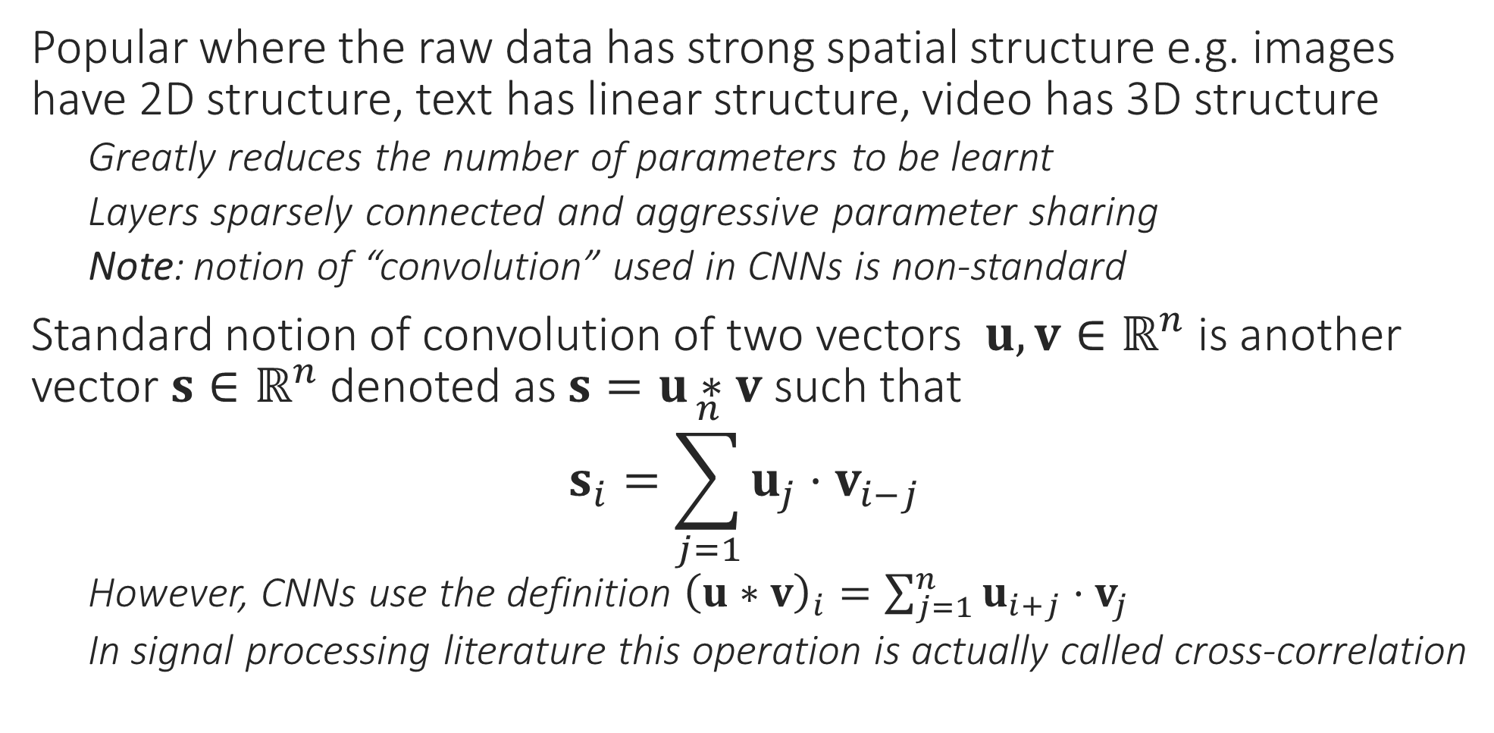
Convolutional Neural Network
Popular where the raw data has strong spatial structure e.g. images have 2D structure, text has linear structure, video has 3D structure
Greatly reduces the number of parameters to be learnt
Layers sparsely connected and aggressive parameter sharing
Note: notion of “convolution” used in CNNs is non-standard
Standard notion of convolution of two vectors $u,v∈ℝ^{n}$ is another vector $s∈ℝ^{n}$ denoted as $s=u∗v$ such that $s_{i}=\sum_{j=1}^{n}{u_{j}{⋅v}_{i−j}}$
However, CNNs use the definition ${\left(u∗v\right)}_{i}=\sum_{j=1}^{n}{u_{i+j}{⋅v}_{j}}$
In signal processing literature this operation is actually called cross-correlation

Slide 16


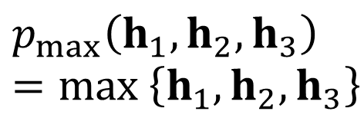

Pooling Operations
Reduce sensitivity of the network to small shifts/errors in image
Max-pooling and average pooling most common
“Stride” length – number of nodes after which a new “pool” is started. Stride = 3 here
$$p$$
$$p$$
$$p_{max}\left(h_{1},h_{2},h_{3}\right)=\max\left\{h_{1},h_{2},h_{3}\right\}$$
$$p_{avg}\left(h_{1},h_{2},h_{3}\right)=\frac{1}{3}\left(h_{1}+h_{2}+h_{3}\right)$$

Slide 17
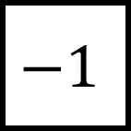
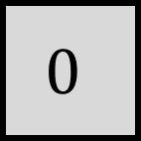
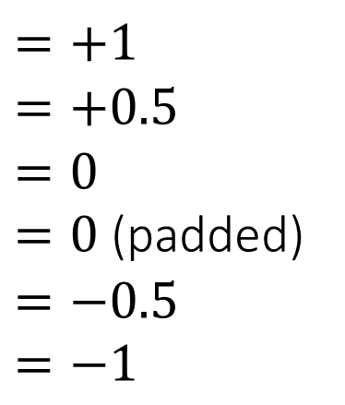
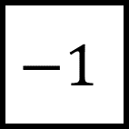
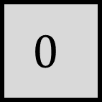
Simple Operations using Conv and Pool
Max Pooling (stride 1x2)
We may verify that 2x2 stride leads to too much info loss
Raw Image
Kernels
Convolved Image
$$0$$
$$−1$$
Detects horizontal edges!
$$=+1$$
$$=+0.5$$
$$=0$$
$=0$ (padded)
$$=−0.5 \\ =−1$$
$$0$$
$$−1$$
Detects vertical edges!
Max Pooling (stride 2x1)
Images are often padded with zero pixels so that convolved image is of same size

Slide 18
Pooling and Strides – an example
1 | 2 | 3 | 4 | 5
9 | 8 | 7 | 6 | 0
0 | 2 | 4 | 6 | 8
2 | 3 | 4 | 5 | 1
6 | 7 | 8 | 9 | 0
0
0
0
0
0
0
2 x 2 max pool
2 x 1 stride
9 | 8 | 7 | 6 | 5
3 | 4 | 6 | 8 | 8
7 | 8 | 9 | 9 | 0
0 | 0 | 0 | 0 | 0
Padding

Slide 19
Pooling and Strides – an example
1 | 2 | 3 | 4 | 5
9 | 8 | 7 | 6 | 0
0 | 2 | 4 | 6 | 8
2 | 3 | 4 | 5 | 1
6 | 7 | 8 | 9 | 0
0
0
0
0
0
0
2 x 2 max pool
2 x 1 stride
9 | 8 | 7 | 6 | 5
3 | 4 | 6 | 8 | 8
7 | 8 | 9 | 9 | 0
9 | 7 | 5
9 | 7 | 8
3 | 6 | 8
7 | 9 | 1
7 | 9 | 1
2 x 2 max pool
1 x 2 stride
0 | 0 | 0 | 0 | 0
Padding

Slide 20
Using CNNs in Computer Vision
3 kernels used to create 3 channels
Kernels learnt using backprop
Maxpooling often done across channels too
Think of each channel (kernel) acting as a feature e.g. one kernel may tell if there is a vertical edge or not, another might tell if there is a diagonal edge or not. Maxpooling across channels is like asking if at least one of the features is active or is it the case that all features are inactive (no edges)
True. However, note that even CNNs usually have a top layer that is dense i.e. weights that connect the last hidden layer to output layer are usually dense since it is assumed that by then all features that had to be learnt, have been learnt and so now all we need is a linear function over those.
CNNs are very popular in image/video processing and recently, even in NLP and text processing. However, we will not go into further details on CNN training in this course. Backprop gets more involved with pooling and convolution layers.

Slide 21
Recurrent Networks
Need for recurrent networks (local features for sequence data)
Notions of convolutions and pooling
Creating multi-layered convolutional networks

Slide 22
Structured Data needs Local Features
The quick brown fox jumps over the lazy dog
Neighbouring words help identify part of speech, adjective, noun etc
Specific sequences of POS can be combined to form phrases (NP, VP)
NP = noun phrase, VP = verb phrase
This is repeated hierarchically
Note that “fox” and “dog” interact only at the “sentence” level
More importantly in a context free grammar, same rules apply to, e.g., detect a noun phrase no matter where in sentence we are looking!
DET ADJ ADJ NN VV PP DET ADJ NN
NP VV PP NP
NP VP
S
CNNs may be (and are) applied to such data as well since even here, we are looking for local features. However, special NN are designed for sequence data e.g. text, DNA

Slide 23
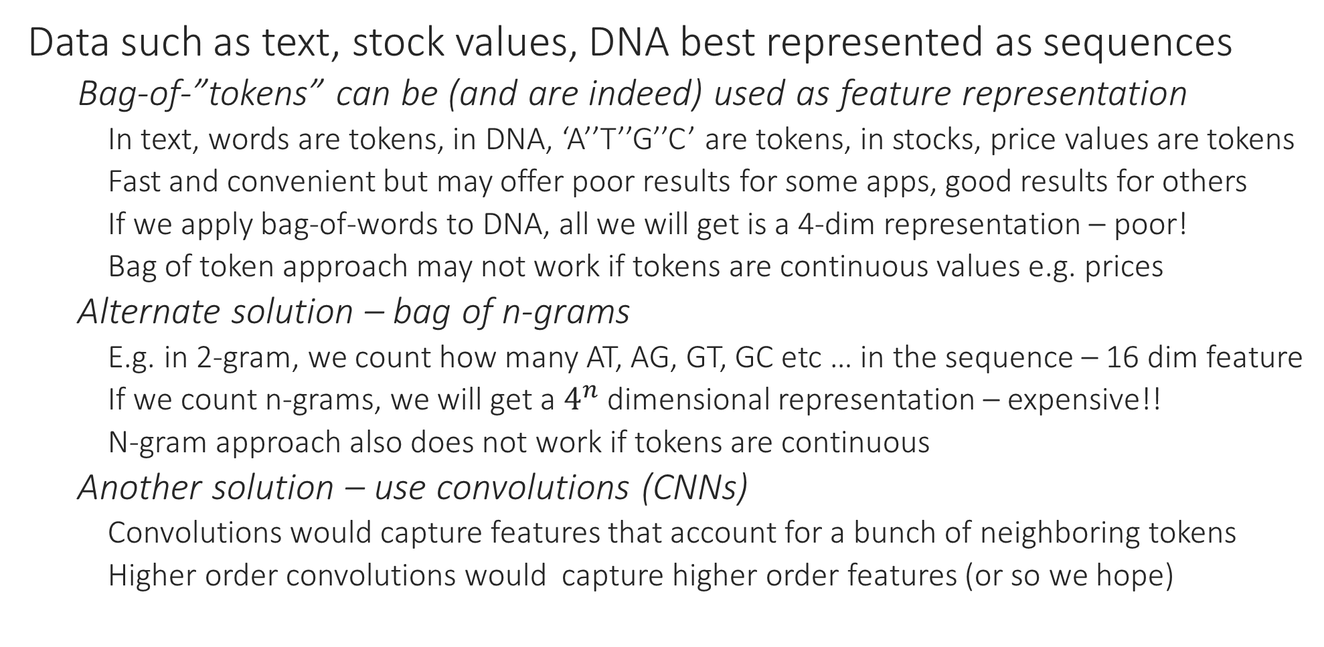
Learning with Sequence Data
Data such as text, stock values, DNA best represented as sequences
Bag-of-”tokens” can be (and are indeed) used as feature representation
In text, words are tokens, in DNA, ‘A’’T’’G’’C’ are tokens, in stocks, price values are tokens
Fast and convenient but may offer poor results for some apps, good results for others
If we apply bag-of-words to DNA, all we will get is a 4-dim representation – poor!
Bag of token approach may not work if tokens are continuous values e.g. prices
Alternate solution – bag of n-grams
E.g. in 2-gram, we count how many AT, AG, GT, GC etc … in the sequence – 16 dim feature
If we count n-grams, we will get a $4^{n}$ dimensional representation – expensive!!
N-gram approach also does not work if tokens are continuous
Another solution – use convolutions (CNNs)
Convolutions would capture features that account for a bunch of neighboring tokens
Higher order convolutions would capture higher order features (or so we hope)

Slide 24
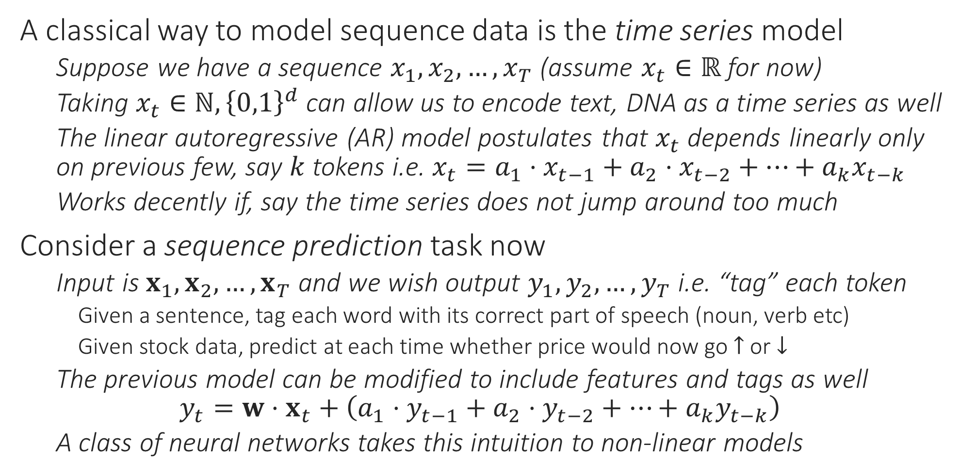
Learning with Sequence Data
A classical way to model sequence data is the time series model
Suppose we have a sequence $x_{1},x_{2},…,x_{T}$ (assume $x_{t}∈ℝ$ for now)
Taking $x_{t}∈ℕ,{\left\{0,1\right\}}^{d}$ can allow us to encode text, DNA as a time series as well
The linear autoregressive (AR) model postulates that $x_{t}$ depends linearly only on previous few, say $k$ tokens i.e. $x_{t}=a_{1}⋅x_{t−1}+a_{2}⋅x_{t−2}+…+a_{k}x_{t−k}$
Works decently if, say the time series does not jump around too much
Consider a sequence prediction task now
Input is $x_{1},x_{2},…,x_{T}$ and we wish output $y_{1},y_{2},…,y_{T}$ i.e. “tag” each token
Given a sentence, tag each word with its correct part of speech (noun, verb etc)
Given stock data, predict at each time whether price would now go $↑$ or $↓$
The previous model can be modified to include features and tags as well $y_{t}=w⋅x_{t}+\left(a_{1}⋅y_{t−1}+a_{2}⋅y_{t−2}+…+a_{k}y_{t−k}\right)$
A class of neural networks takes this intuition to non-linear models

Slide 25



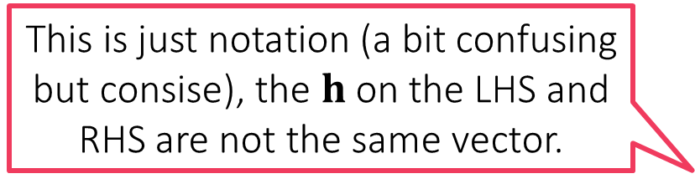


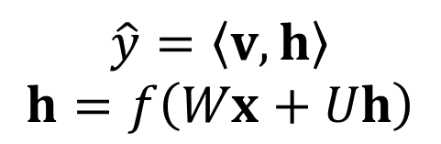

Recurrent Neural Networks
For sake of notational clarity, we now represent all hidden layers, all nodes in those hidden layers, using a single hidden layer node
Recurrent neural networks in some sense, create a virtual copy of this network for every point in the time series and allow these copies to share information
$$f$$
$$y$$
$$\hat{y}=\left\langle v,h\right\rangle \\ h=f\left(Wx+Uh\right)$$
$$\hat{y}=\left\langle v,h\right\rangle \\ h=f\left(Wx\right)$$
$$h$$
This is just notation (a bit confusing but consise), the $h$ on the LHS and RHS are not the same vector.
$$x$$
$$x$$

Slide 26









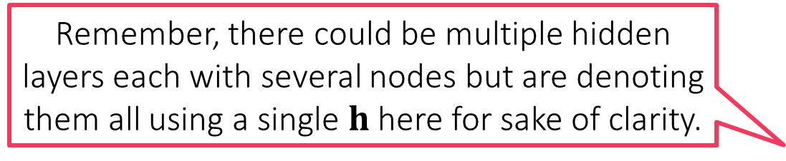







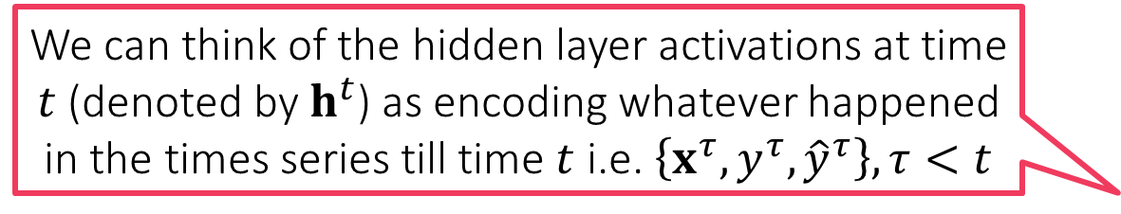












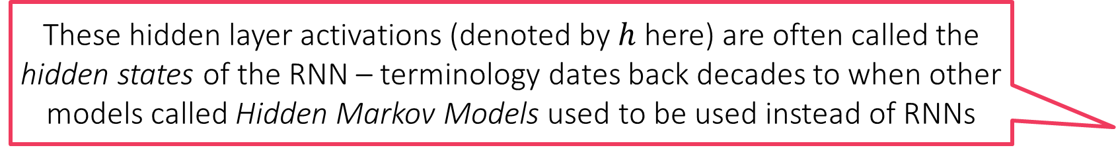

Recurrent Neural Networks
$$y^{1}$$
$$y^{2}$$
$$y^{3}$$
$$y^{4}$$
${\hat{y}}^{t}=\left\langle v,h^{t}\right\rangle$
$h^{t}=f\left(Wx^{t}+Uh^{t−1}\right)$
${\hat{y}}^{t}$ can do POS tagging etc
${\hat{y}}^{t}$ can even be a vector ${\hat{y}}^{t}$
Can have several hidden layers some recurrent i.e. receive input from their counterparts in previous time steps, others can be non recurrent as well
RNNs allow lot of freedom but get harder to train
These hidden layer activations (denoted by $h$ here) are often called the hidden states of the RNN – terminology dates back decades to when other models called Hidden Markov Models used to be used instead of RNNs
$$v$$
$$v$$
$$v$$
$$v$$
$$U$$
$$U$$
$$U$$
$$U$$
$$…$$
$$U$$
$$h^{0}$$
$$h^{1}$$
$$h^{2}$$
$$h^{3}$$
$$h^{4}$$
Remember, there could be multiple hidden layers each with several nodes but are denoting them all using a single $h$ here for sake of clarity.
$$W$$
$$W$$
$$W$$
$$W$$
$$…$$
$$x_{1}$$
$$x_{2}$$
We can think of the hidden layer activations at time $t$ (denoted by $h^{t}$) as encoding whatever happened in the times series till time $t$ i.e. $\left\{x^{τ},y^{τ},{\hat{y}}^{τ}\right\},τ<t$
$$x_{3}$$
$$x_{4}$$
The quick brown fox …

Slide 27


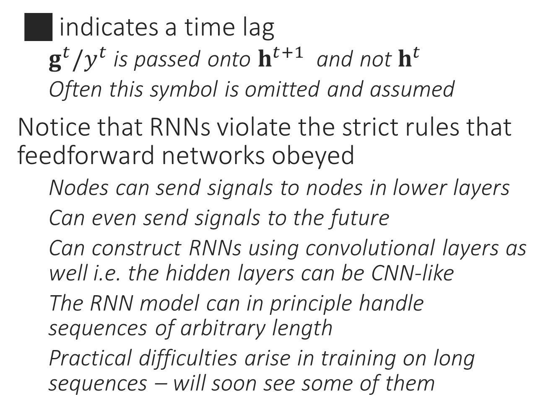










RNN Variants
$$y$$
$$y$$
$$y$$
 indicates a time lag
$g^{t}/y^{t}$ is passed onto $h^{t+1}$ and not $h^{t}$
Often this symbol is omitted and assumed
Notice that RNNs violate the strict rules that feedforward networks obeyed
Nodes can send signals to nodes in lower layers
Can even send signals to the future
Can construct RNNs using convolutional layers as well i.e. the hidden layers can be CNN-like
The RNN model can in principle handle sequences of arbitrary length
Practical difficulties arise in training on long sequences – will soon see some of them
$$g$$
$$g$$
$$g$$
$$h$$
$$h$$
$$h$$
$$x$$
$$x$$
$$x$$

Slide 28



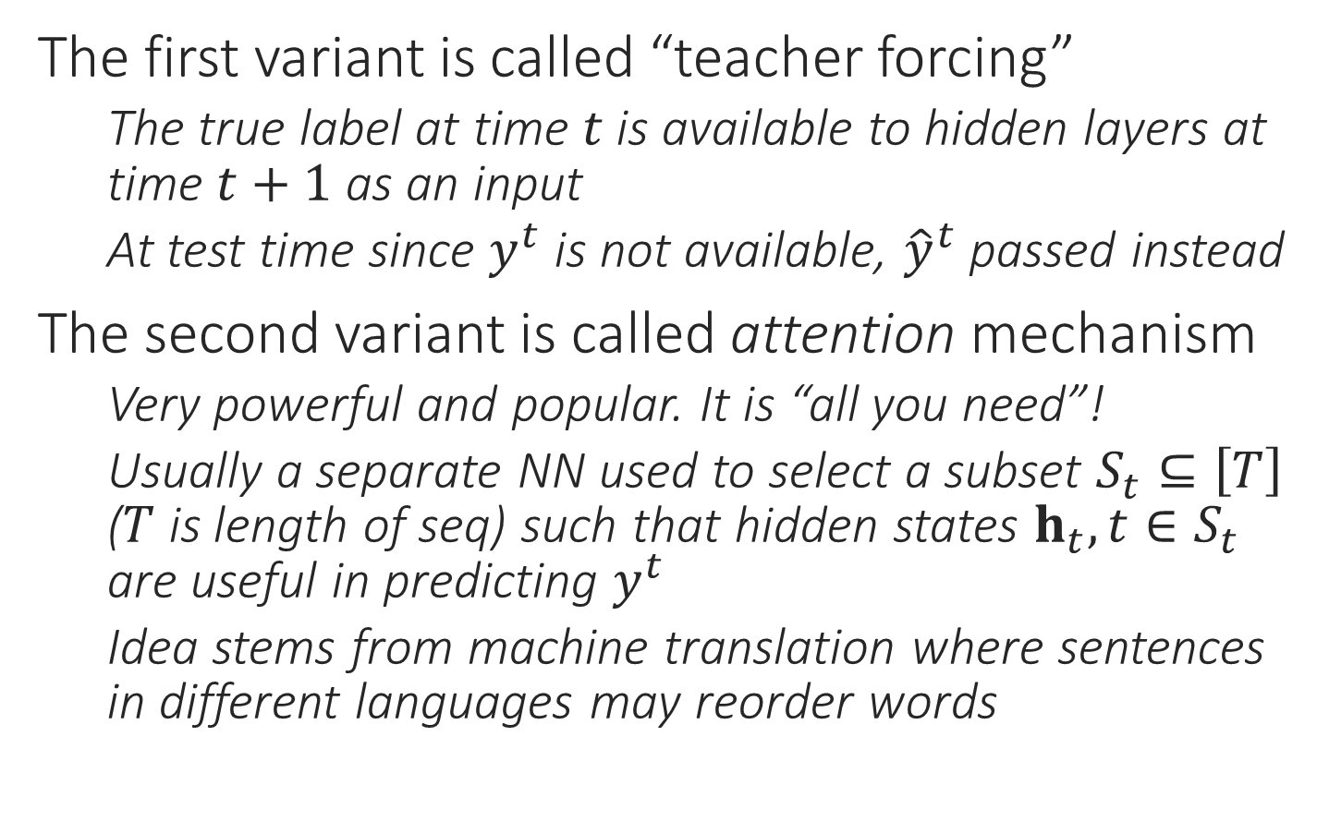





RNN Variants
$$y$$
$$y$$
The first variant is called “teacher forcing”
The true label at time $t$ is available to hidden layers at time $t+1$ as an input
At test time since $y^{t}$ is not available, ${\hat{y}}^{t}$ passed instead
The second variant is called attention mechanism
Very powerful and popular. It is “all you need”!
Usually a separate NN used to select a subset $S_{t}⊆\left[T\right]$ ($T$ is length of seq) such that hidden states $h_{t},t∈S_{t}$ are useful in predicting $y^{t}$
Idea stems from machine translation where sentences in different languages may reorder words
$$g$$
$$g$$
$$h$$
$$h$$
$$x$$
$$x$$

Slide 29
Applications of RNNs
Aligned Seq2Seq
Sequence to Single
Single to Sequence
Non-aligned Seq2Seq
POS tagging, predicting next word, language model learning, labelling frames of a video
Sentiment analysis, video/document classification
Image captioning
Machine translation, query rewriting, error correction in input seq

Slide 30
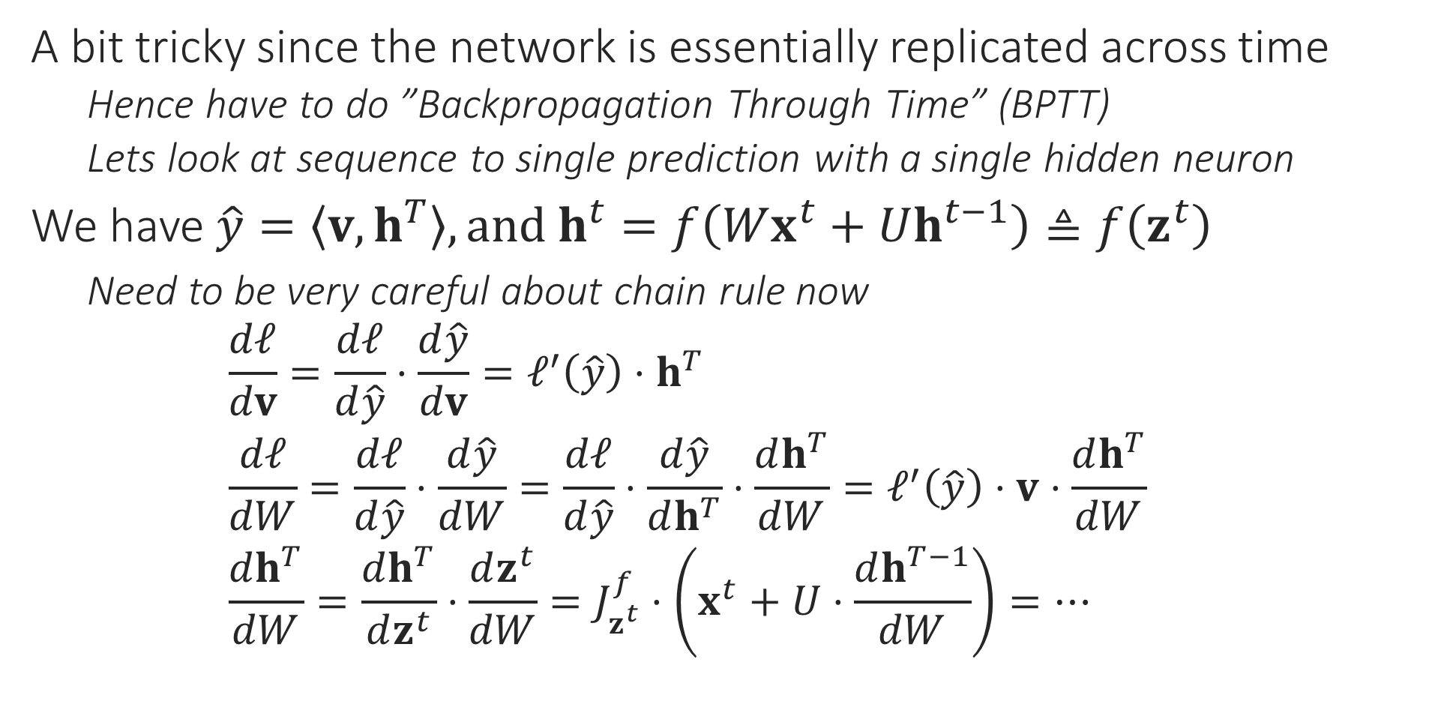
Backprop with RNNs
A bit tricky since the network is essentially replicated across time
Hence have to do ”Backpropagation Through Time” (BPTT)
Lets look at sequence to single prediction with a single hidden neuron
We have $\hat{y}=\left\langle v,h^{T}\right\rangle , and h^{t}=f\left(Wx^{t}+Uh^{t−1}\right)≜f\left(z^{t}\right)$
Need to be very careful about chain rule now $\frac{dℓ}{dv}=\frac{dℓ}{d\hat{y}}⋅\frac{d\hat{y}}{dv}=ℓ^{′}\left(\hat{y}\right)⋅h^{T}$ $\frac{dℓ}{dW}=\frac{dℓ}{d\hat{y}}⋅\frac{d\hat{y}}{dW}=\frac{dℓ}{d\hat{y}}⋅\frac{d\hat{y}}{dh^{T}}⋅\frac{dh^{T}}{dW}=ℓ^{′}\left(\hat{y}\right)⋅v⋅\frac{dh^{T}}{dW}$ $\frac{dh^{T}}{dW}=\frac{dh^{T}}{dz^{t}}⋅\frac{dz^{t}}{dW}=J_{z^{t}}^{f}⋅\left(x^{t}+U⋅\frac{dh^{T−1}}{dW}\right)=…$

Slide 31
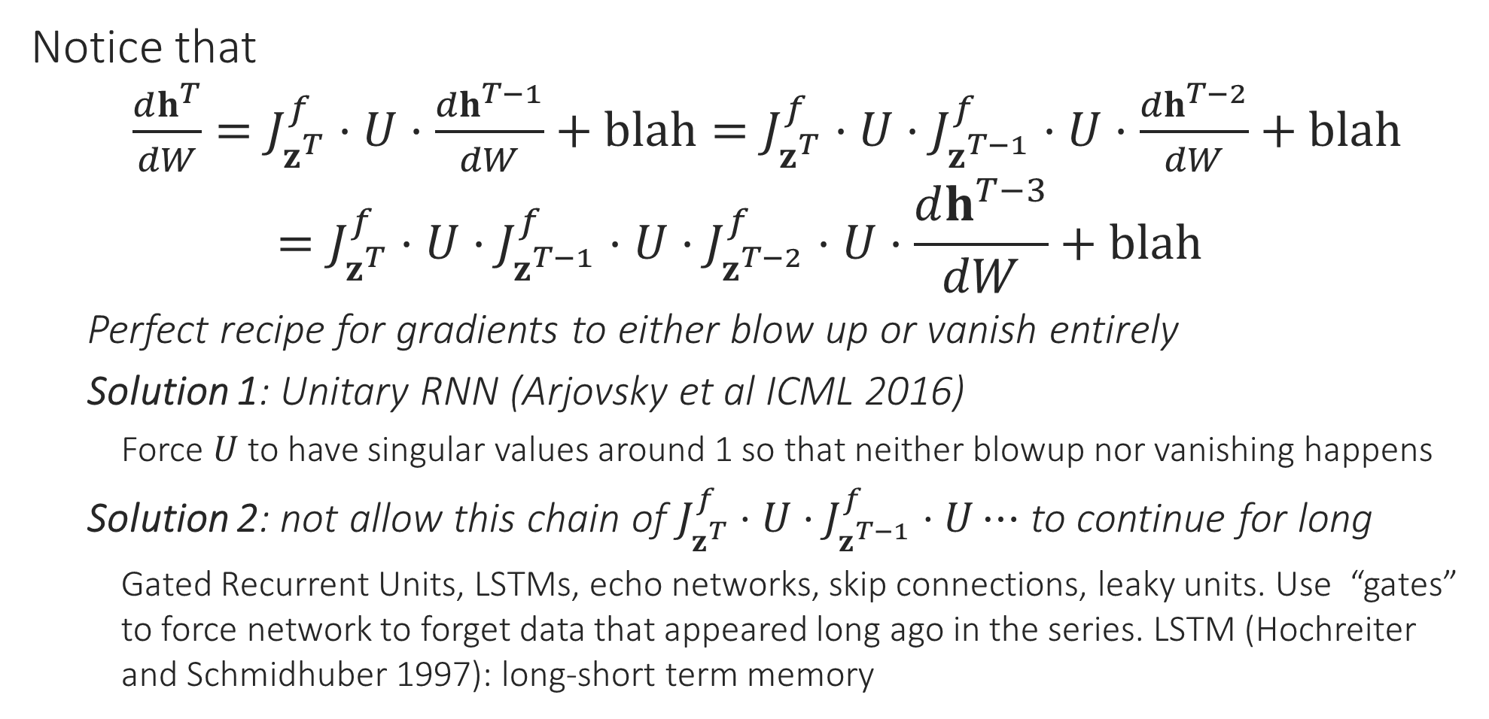
Backprop with RNNs
RNNs are very popular in NLP and more recently in video processing as well. However, we will not go into further details on RNN training in this course.
Notice that $\frac{dh^{T}}{dW}=J_{z^{T}}^{f}⋅U⋅\frac{dh^{T−1}}{dW}+blah=J_{z^{T}}^{f}⋅U⋅J_{z^{T−1}}^{f}⋅U⋅\frac{dh^{T−2}}{dW}+blah$ $=J_{z^{T}}^{f}⋅U⋅J_{z^{T−1}}^{f}⋅U⋅J_{z^{T−2}}^{f}⋅U⋅\frac{dh^{T−3}}{dW}+blah$
Perfect recipe for gradients to either blow up or vanish entirely
Solution 1: Unitary RNN (Arjovsky et al ICML 2016)
Force $U$ to have singular values around 1 so that neither blowup nor vanishing happens
Solution 2: not allow this chain of $J_{z^{T}}^{f}⋅U⋅J_{z^{T−1}}^{f}⋅U⋯$ to continue for long
Gated Recurrent Units, LSTMs, echo networks, skip connections, leaky units. Use “gates” to force network to forget data that appeared long ago in the series. LSTM (Hochreiter and Schmidhuber 1997): long-short term memory

